Slide 1

Shri Vishnu Engineering College for Women::Bhimavaram (Autonomous)
Campus Centric Second Hand Exchange
IV B.Tech II Sem Project power point presentation
In
Computer Science and Engineering
By
1. Mohammed Afreen - 18B01A05G9
2. Sunnapuram Sai Durga – 18B01A05D7
3. Veluguri Lakshmi Sindhu - 18B01A05E6
4. Bathula Gowthami - 18B01A05F6
5. Tadikonda Tejaswi - 18B01A05D8
Under the guidance of
Mr. M. Ramesh Babu, M.Tech(PhD)
Assistant Professor
REVIEW NO: 3
Date: 12 Apr 2022
Department of Computer Science and Engineering Slide No:1

Slide 2
Contents
Problem Statement
Existing System
Proposed System
System Requirements
UML Diagrams
(Use case, Class, Activity, Sequence, Collaboration)
Functionalities
Screens
Results
Conclusion
Department of Computer Science and Engineering Slide No: 2

Slide 3
Problem Description
According to situations around that we are advocating green civilization nowadays, saving resources as much as we can should be an important issue.
As we are new generation students, we enjoy great convenience that sophisticated technology brings to us. Using it to deal with realistic problems is what we ought to do.
That is why this project designs and implements for the campus a second-hand trading website; offering a platform for students trading old items easily.
There are many students who cannot afford the new products, so they can have the opportunity to buy old items.
Department of Computer Science and Engineering Slide No: 3

Slide 4
Problems in Existing system
Existing websites do have fundamental customers.
Since these platforms are open to the whole citizens, we cannot easily find what we need for campus.
Department of Computer Science and Engineering Slide No: 4

Slide 5
Proposed System
A trade website which just focuses on a single university.
This website is a on campus massive potential market of second-handing trading to save money and also to help in protecting the environment.
The students usually generate a great deal of spare items such as books, drafters, chairs, etc can upload their items in this website and sell them.
Department of Computer Science and Engineering Slide No: 5

Slide 6
System Requirements
Software Requirements :
Tools : Eclipse, Visual Studio, NodeJs, MySQL
Front-end : HTML, CSS, Bootstrap, Angular
Back-end : RestAPI, Hibernate
Database : MySQL
Hardware Requirements:
Operating System : Windows8 and above
RAM : 4GB and above
Processor : Intel Core I3 and above
Hard disk space : 500GB and above
Department of Computer Science and Engineering Slide No: 6

Slide 7
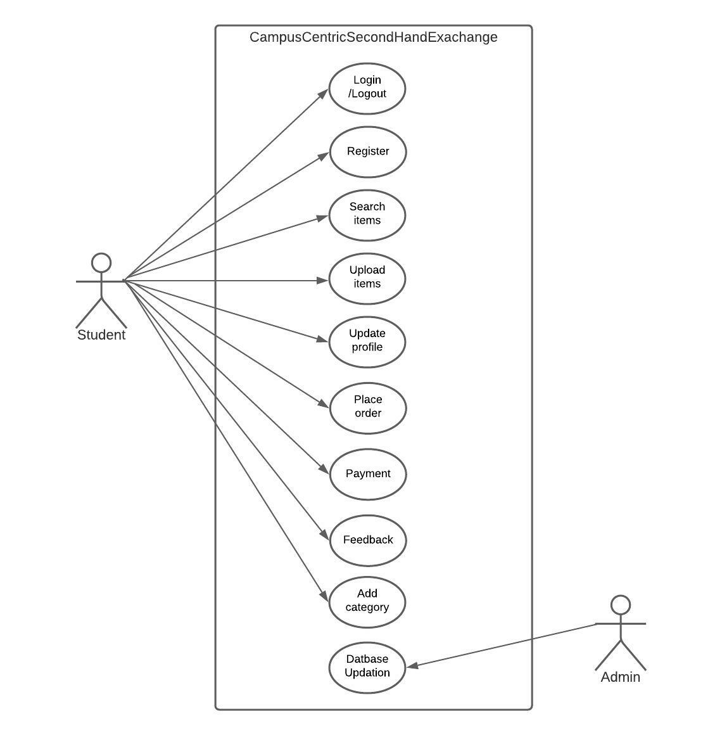
Use Case
Department of Computer Science and Engineering Slide No: 7

Slide 8
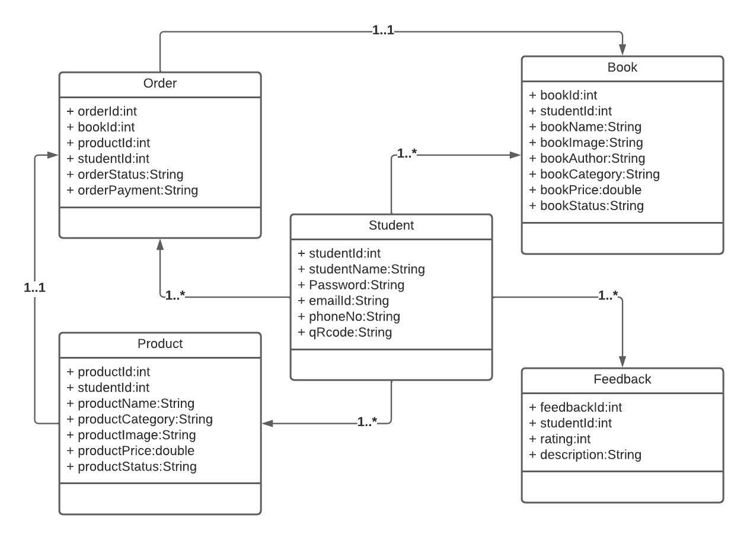
Class Diagram
Department of Computer Science and Engineering Slide No: 8

Slide 9
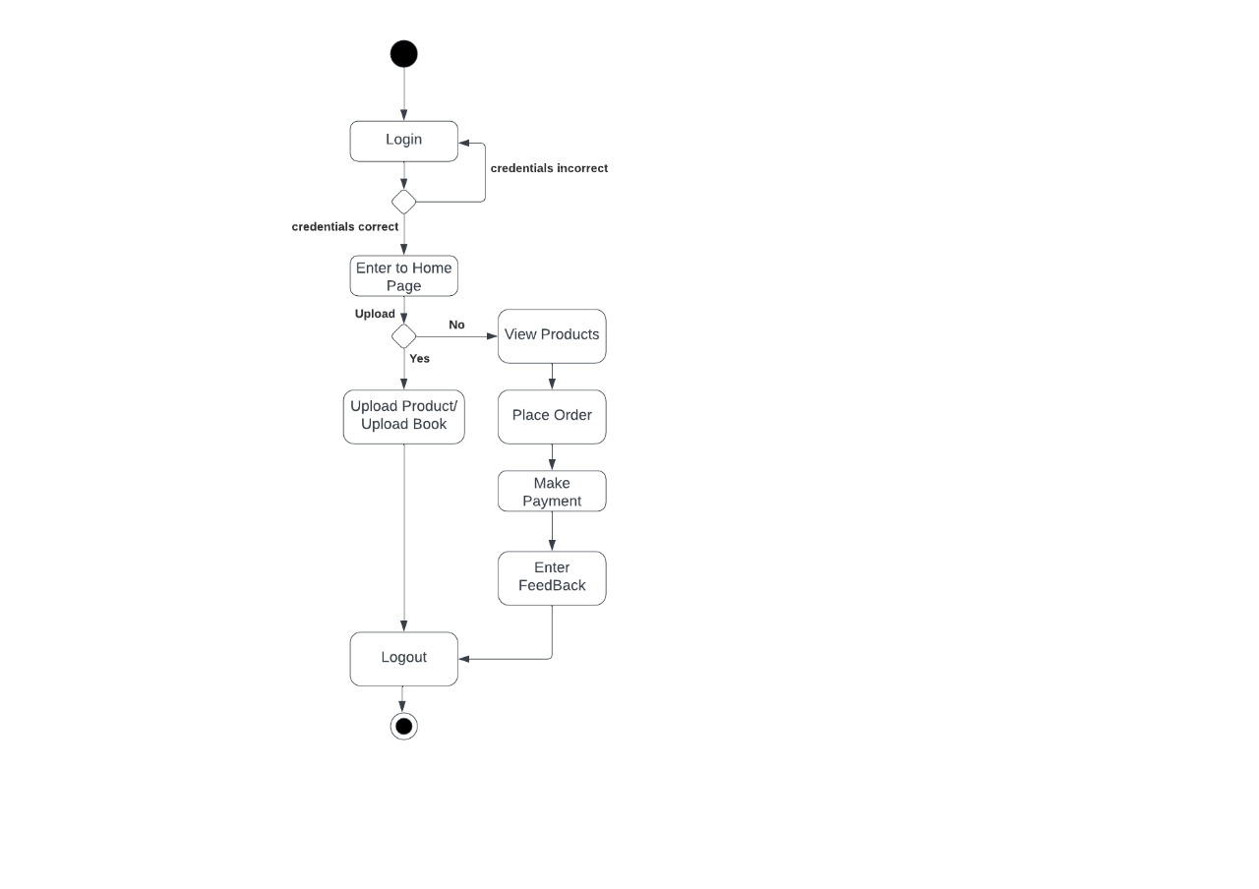
Activity Diagram
Department of Computer Science and Engineering Slide No: 9

Slide 10
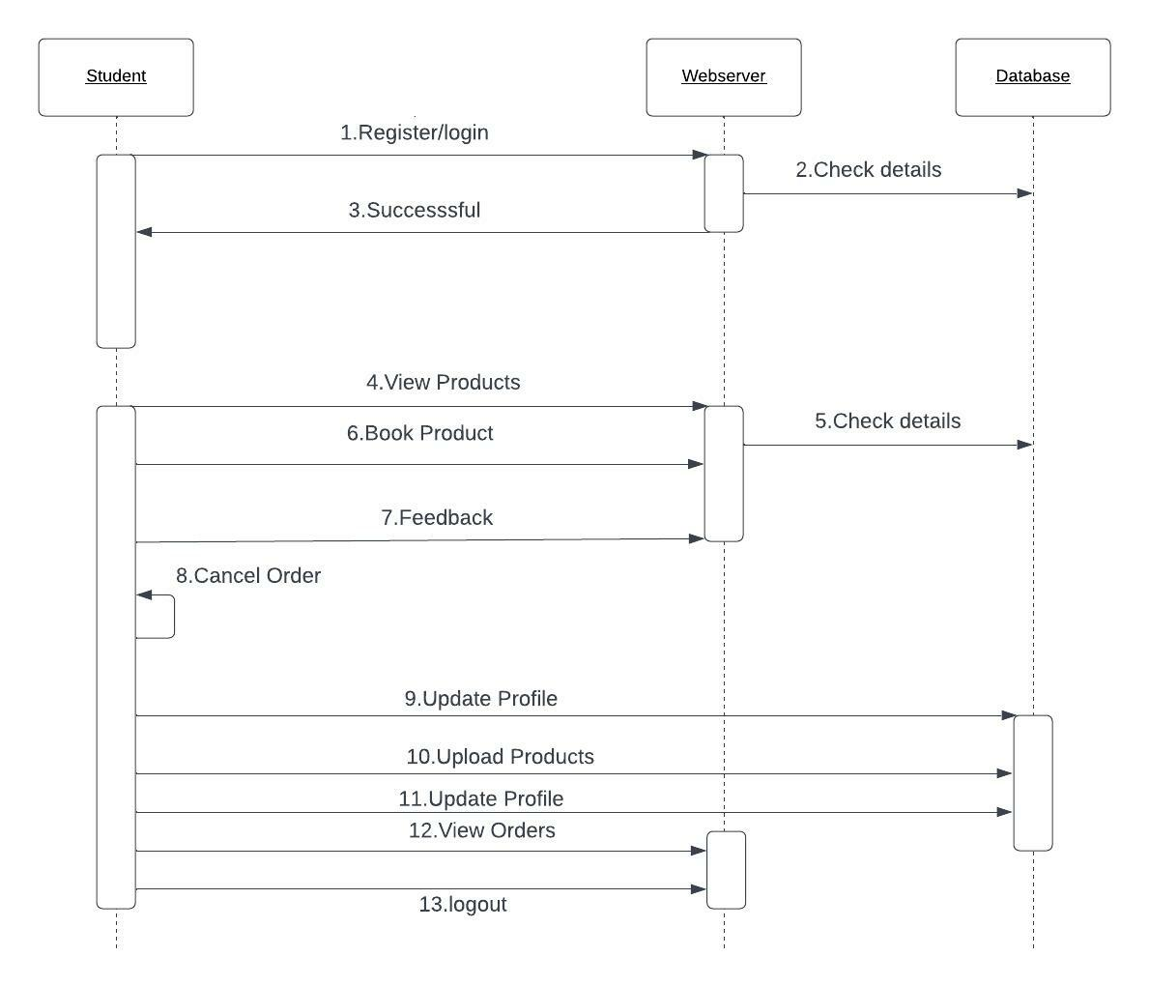
Sequence Diagram
Department of Computer Science and Engineering Slide No: 10

Slide 11
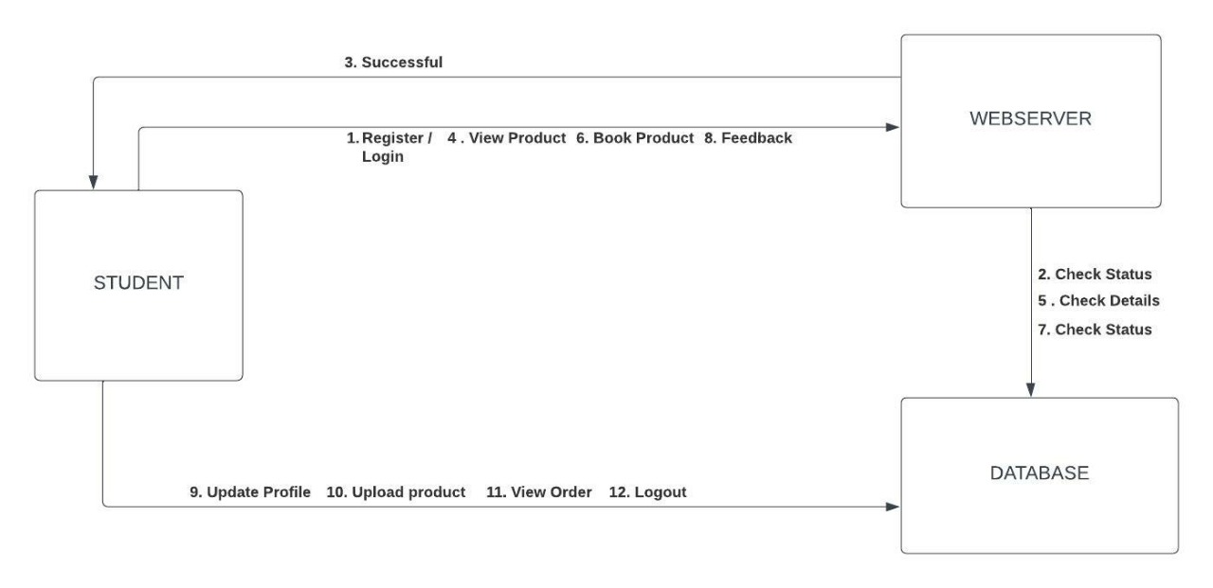
Collaboration Diagram
Department of Computer Science and Engineering Slide No: 11

Slide 12
Functionalities
Registration
User Login
Upload Product
Search Product
Place Order
Share Feedback
Update Profile
Department of Computer Science and Engineering Slide No: 12

Slide 13
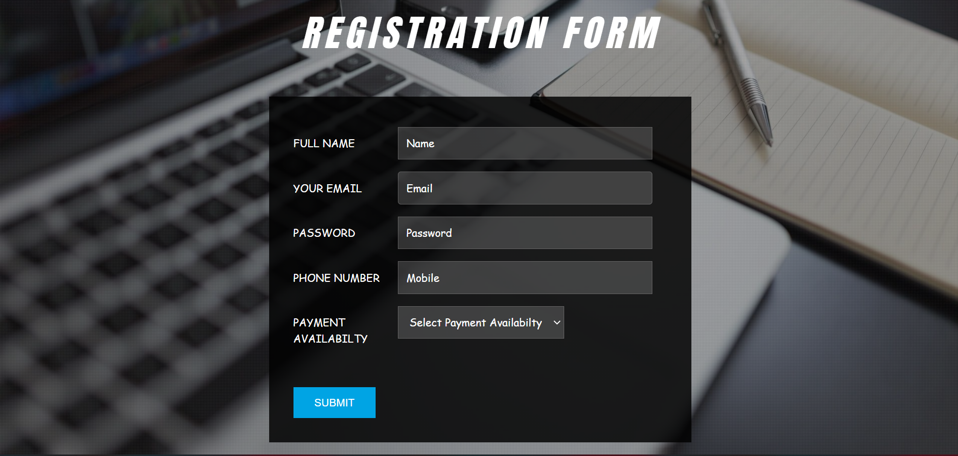
Screens
Department of Computer Science and Engineering Slide No: 13

Slide 14
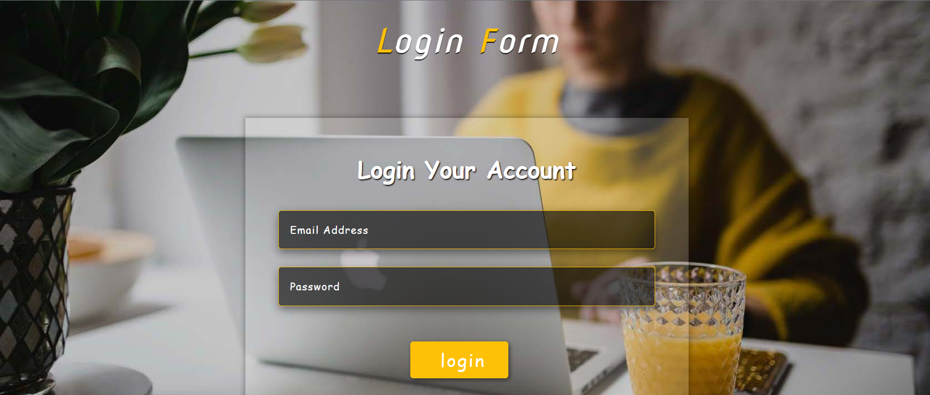
Screens
Department of Computer Science and Engineering Slide No: 14

Slide 15
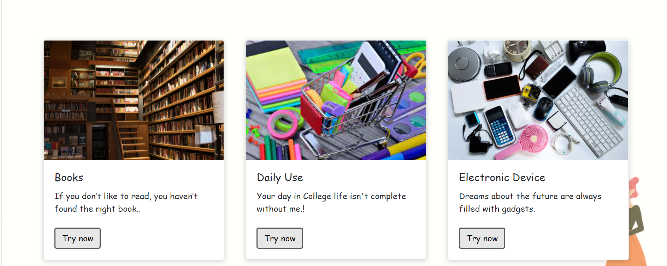
Screens
Department of Computer Science and Engineering Slide No: 15

Slide 16
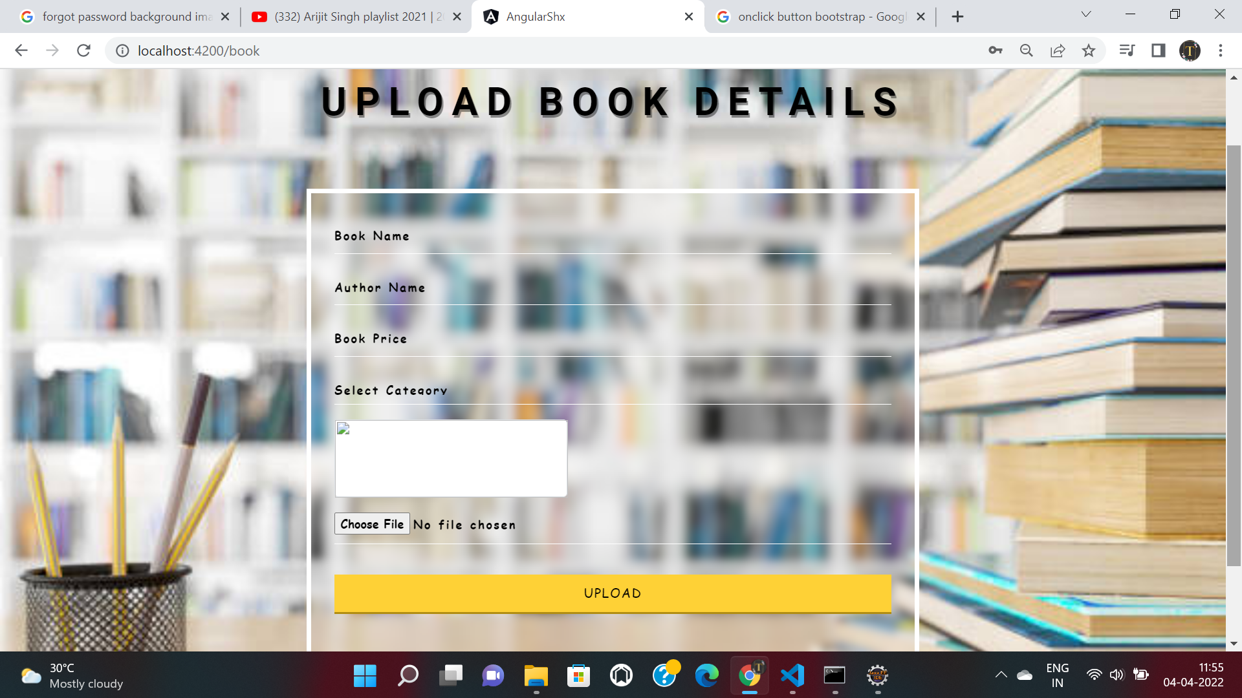
Screens
Department of Computer Science and Engineering Slide No: 16

Slide 17
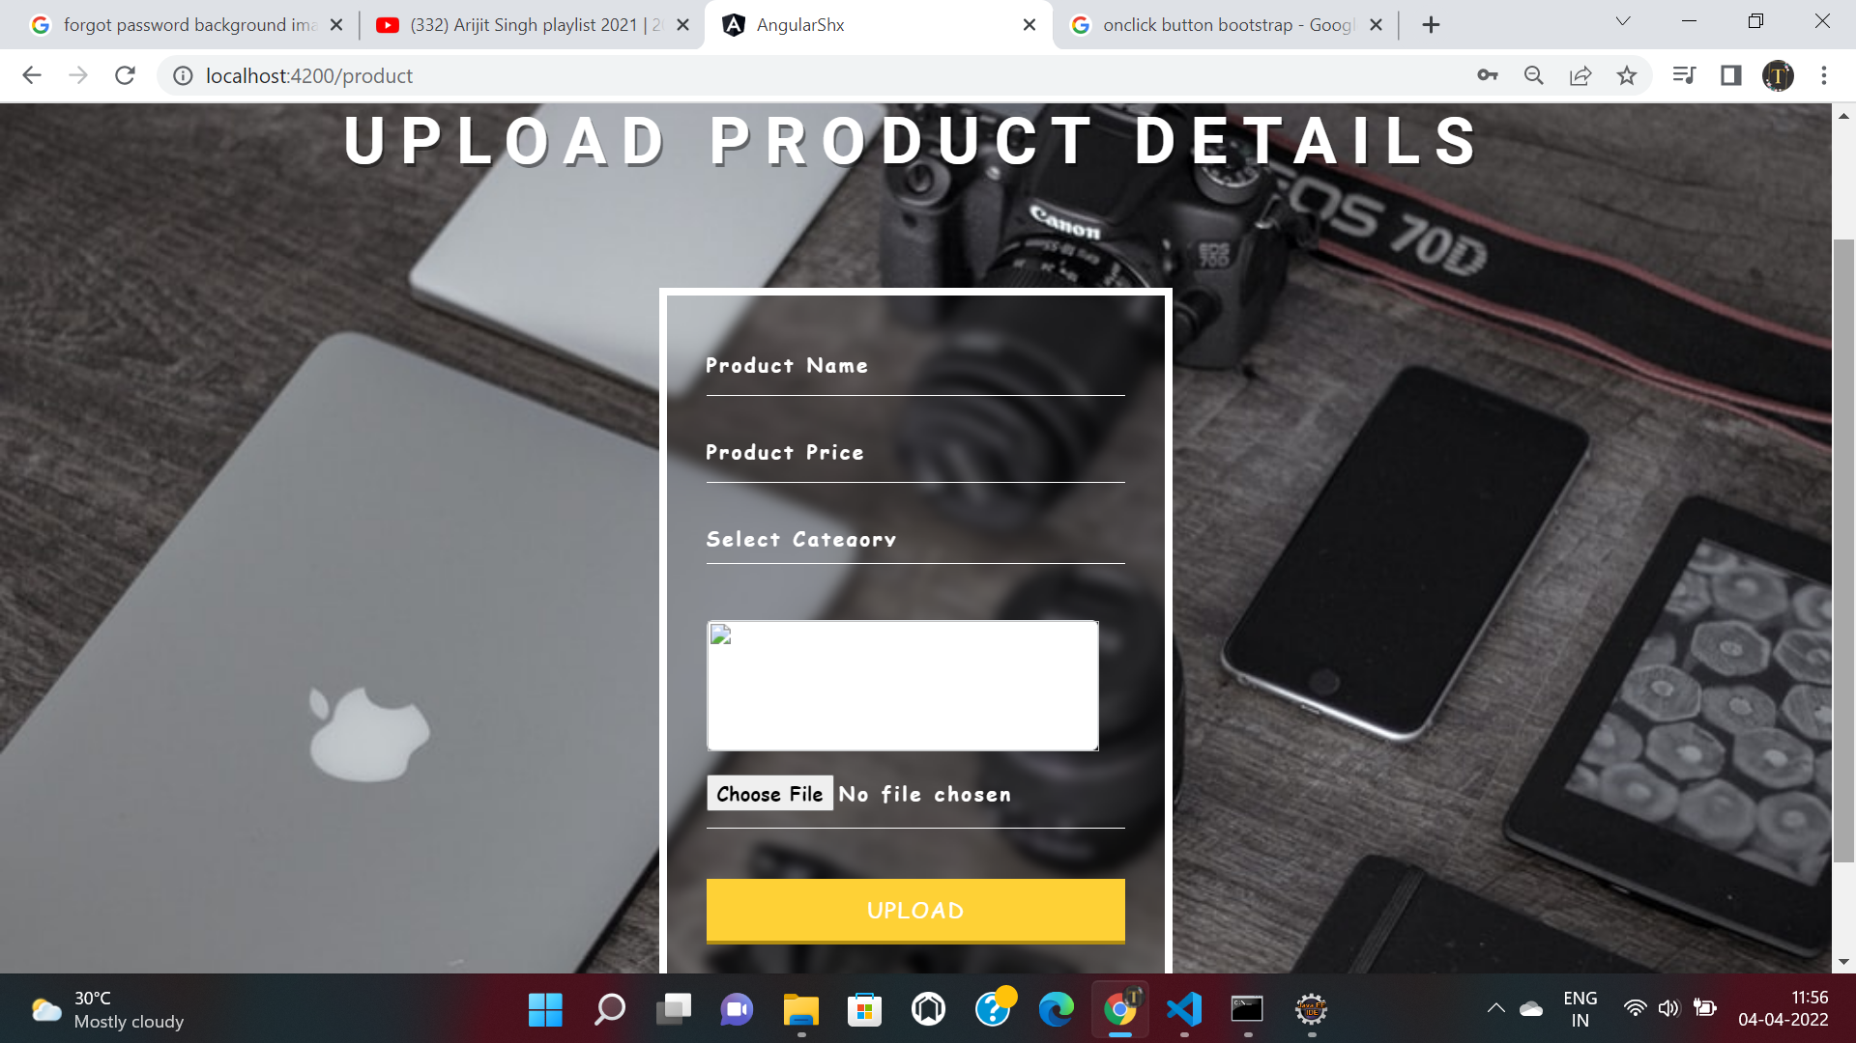
Screens
Department of Computer Science and Engineering Slide No: 17

Slide 18
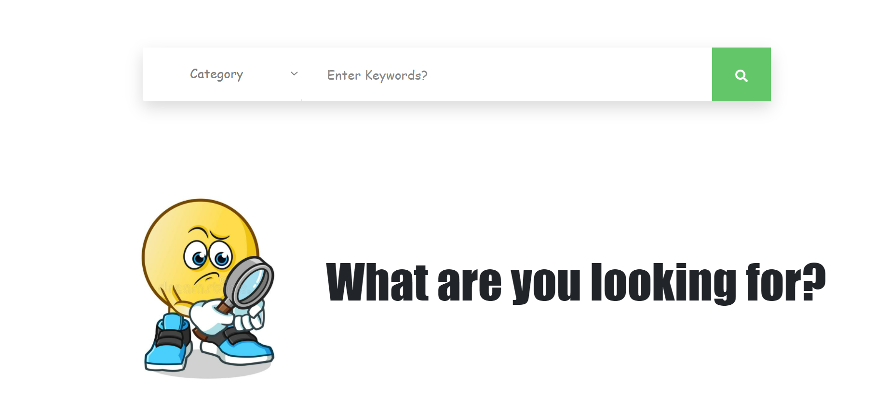
Screens
Department of Computer Science and Engineering Slide No: 18

Slide 19
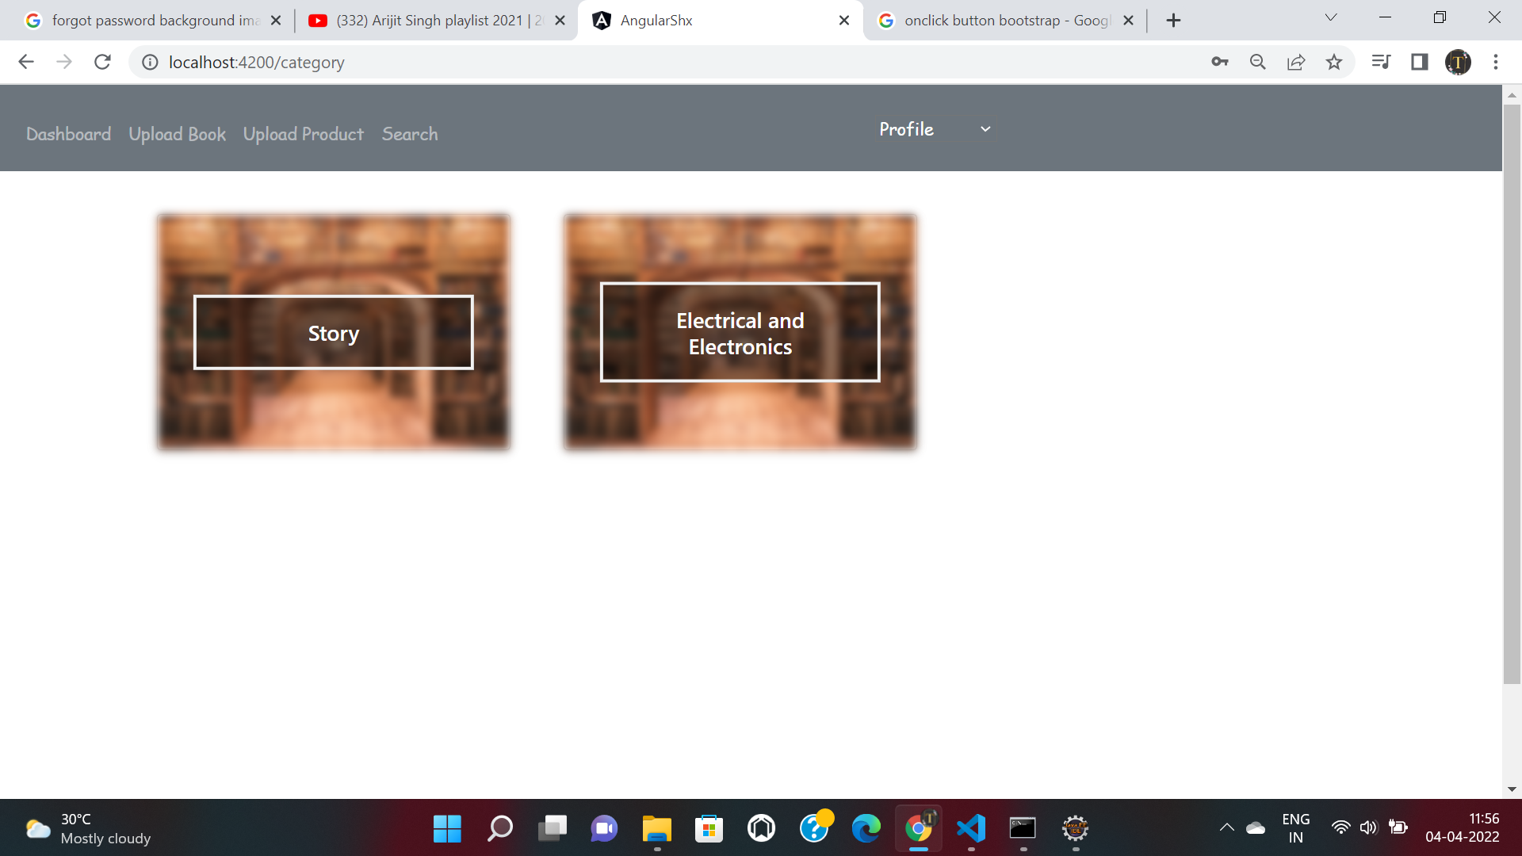
Screens
Department of Computer Science and Engineering Slide No: 19

Slide 20
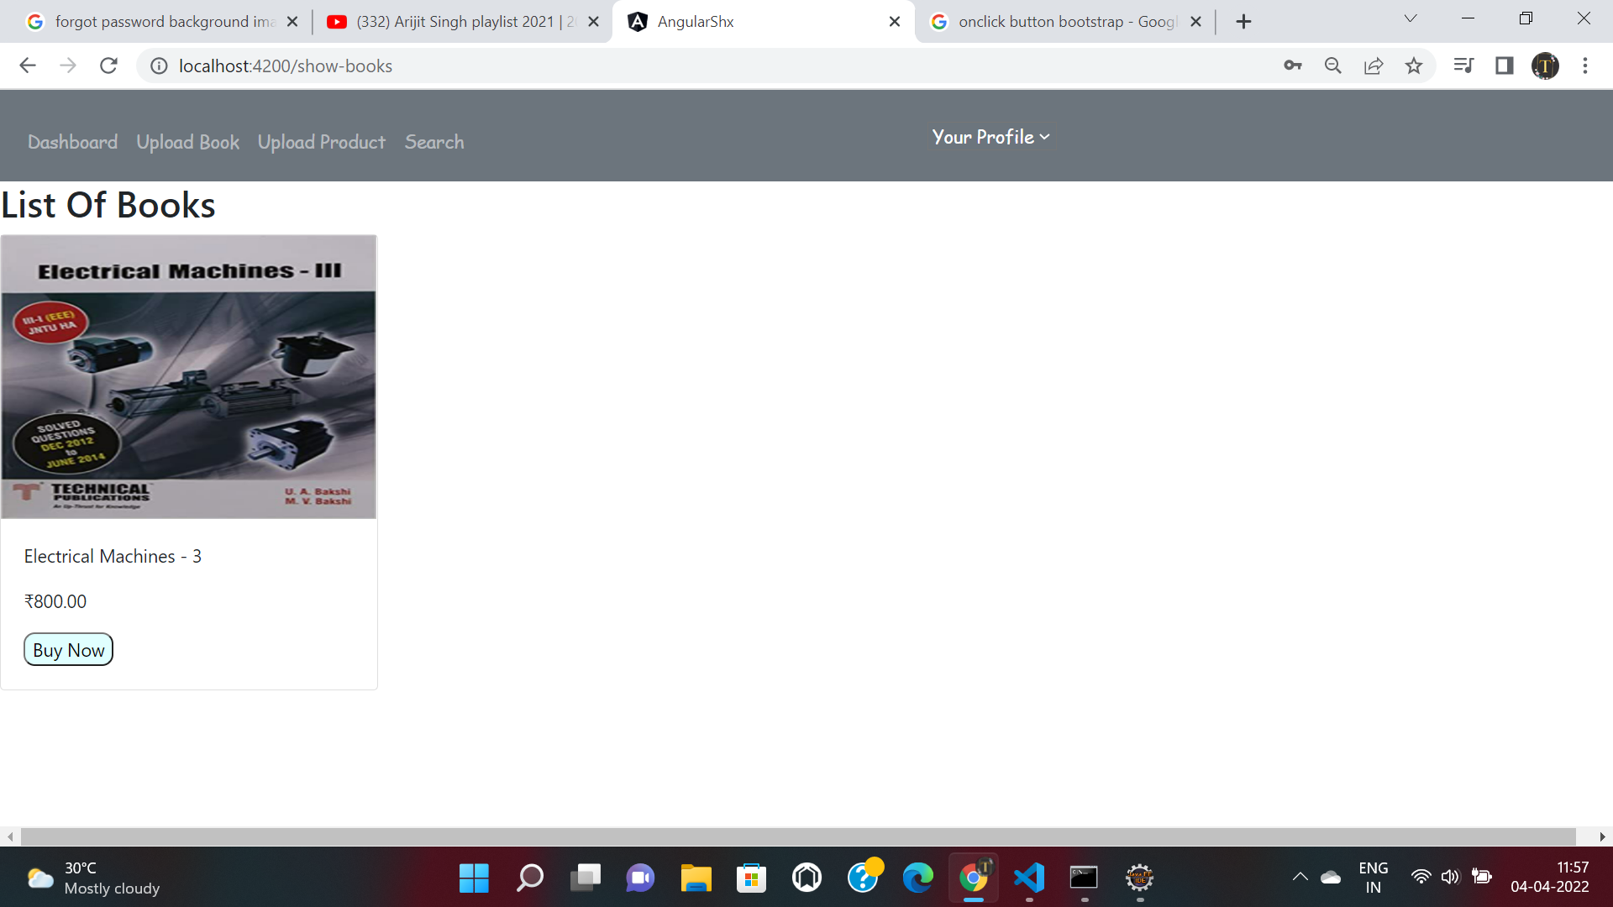
Screens
Department of Computer Science and Engineering Slide No: 20

Slide 21
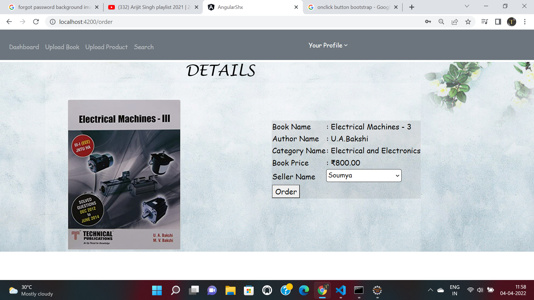
Screens
Department of Computer Science and Engineering Slide No: 21

Slide 22
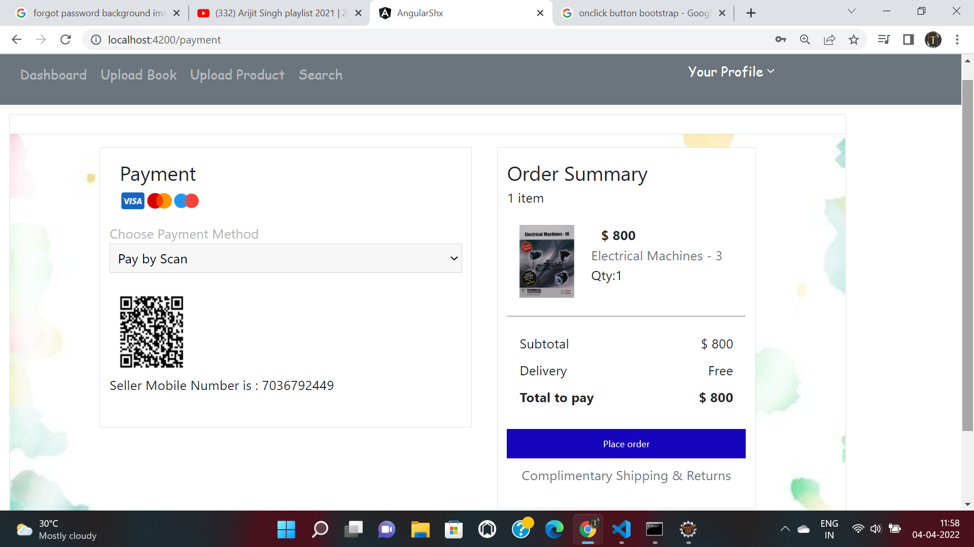
Screens
Department of Computer Science and Engineering Slide No: 22

Slide 23
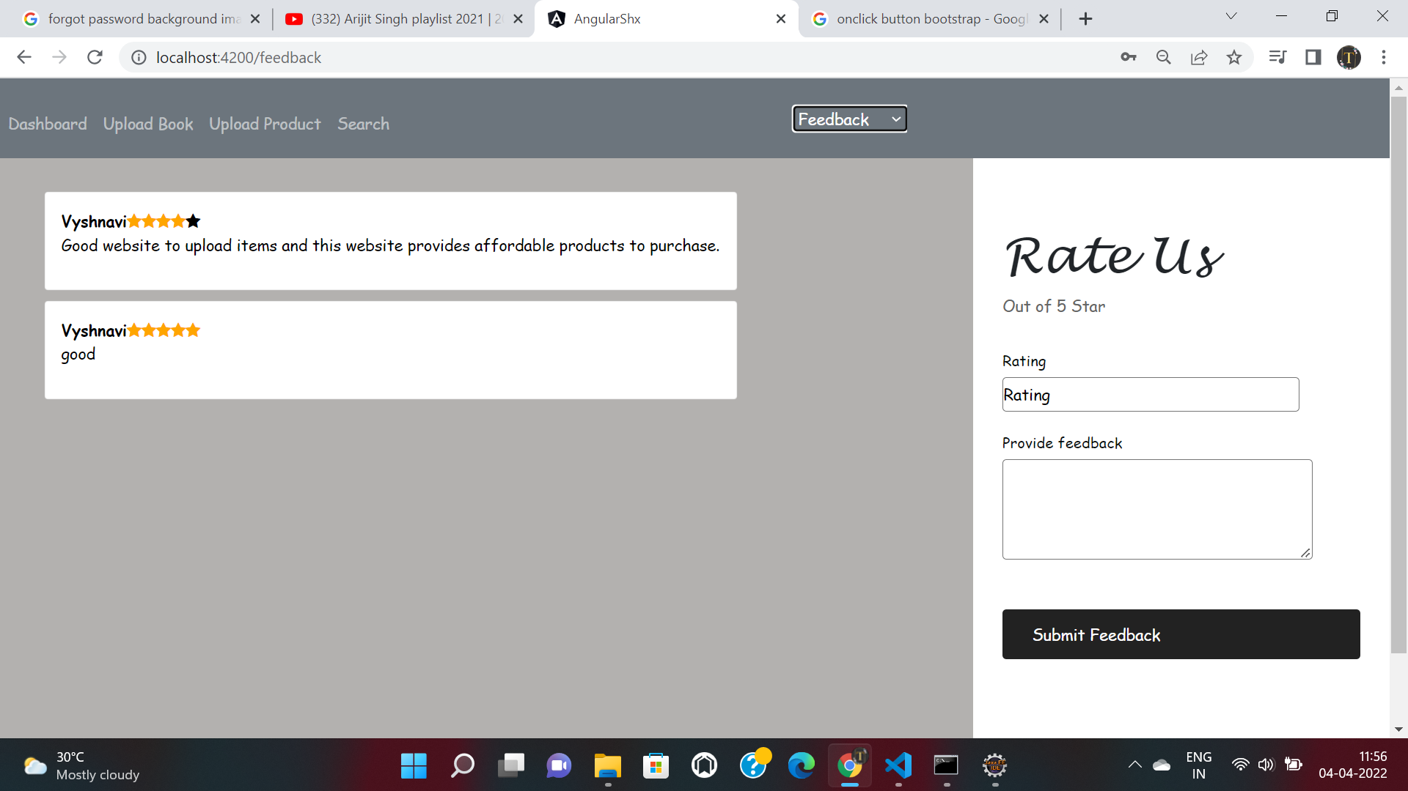
Screens
Department of Computer Science and Engineering Slide No: 23

Slide 24
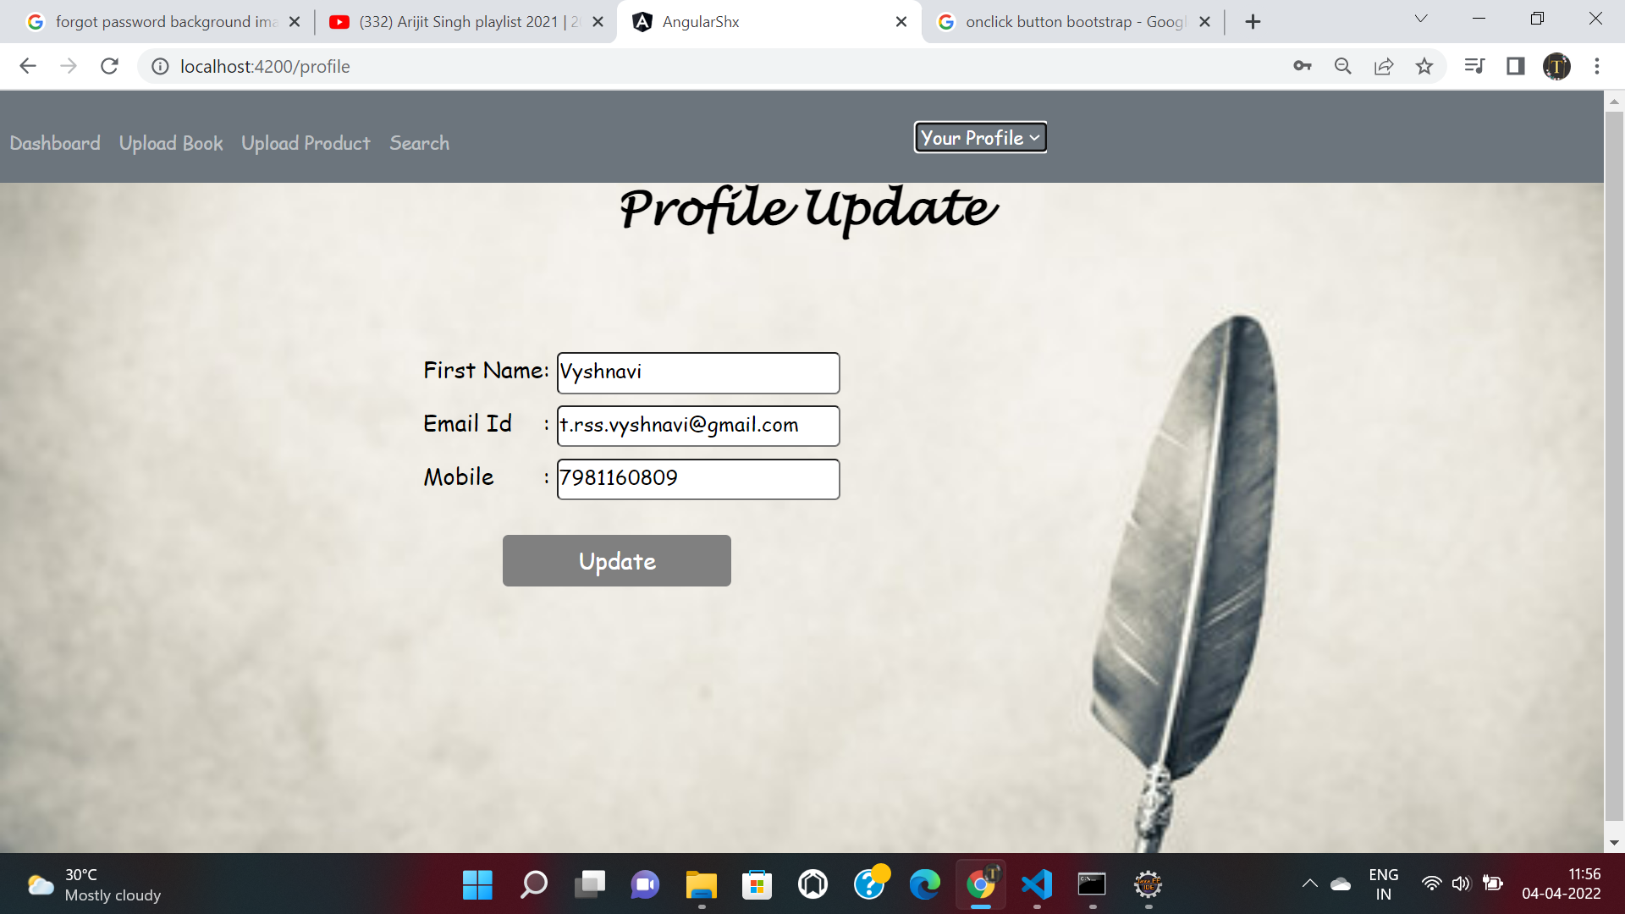
Screens
Department of Computer Science and Engineering Slide No: 24

Slide 25
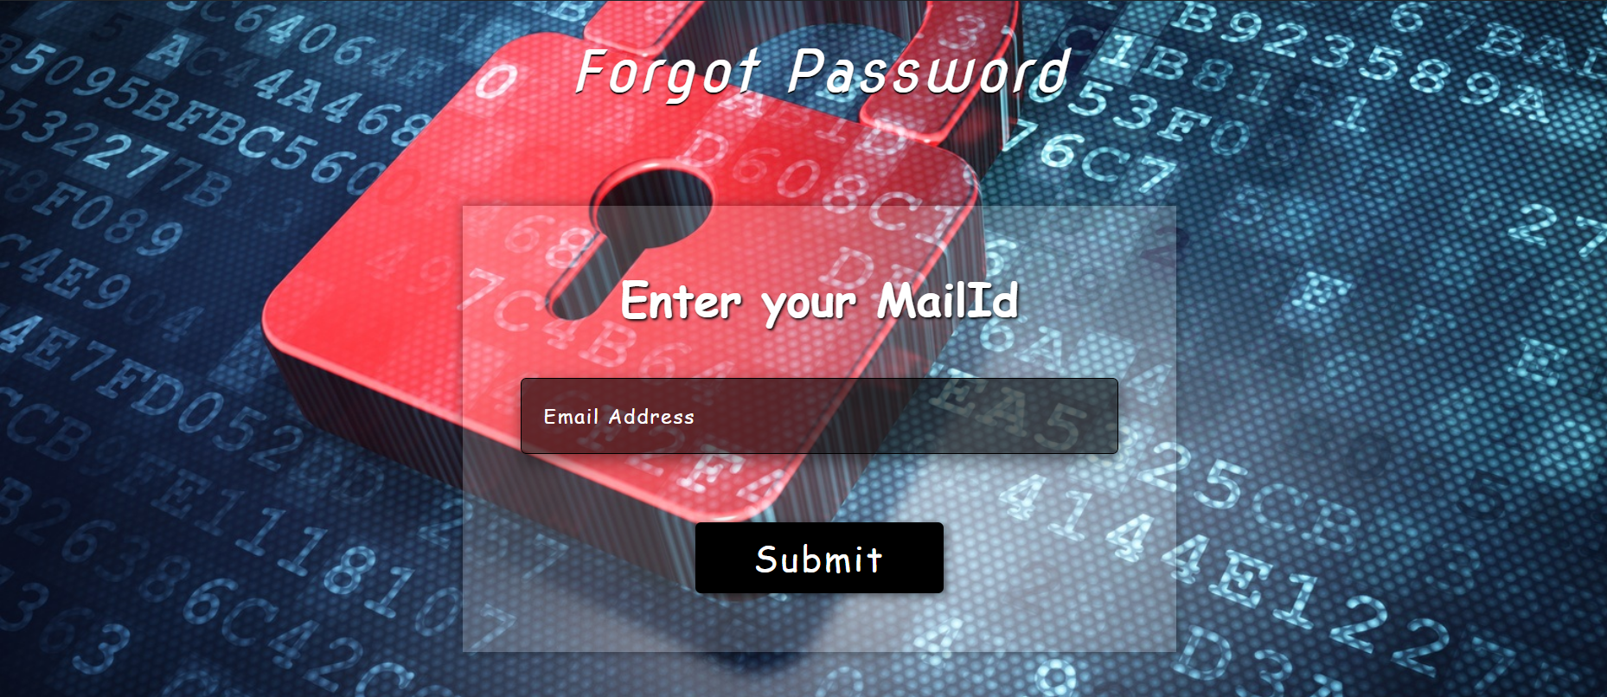
Screens
Department of Computer Science and Engineering Slide No: 24

Slide 26
Results
Implementation – website link
CampusCentricSecondHandExchange
Department of Computer Science and Engineering Slide No: 25

Slide 27
Conclusion
The aim of developing this project is to provide a platform for students to effortless trading of old products. It not only saves students money but also helps to safeguard the environment.
Department of Computer Science and Engineering Slide No: 26

Slide 28
THANK YOU
Department of Computer Science and Engineering Slide No: 27

